Slide 1
Robot Dynamics – Newton- Euler Recursive Approach
ME 4135 Robotics & Controls
R. Lindeke, Ph. D.

Slide 2
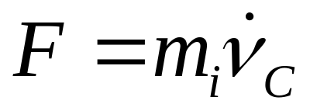
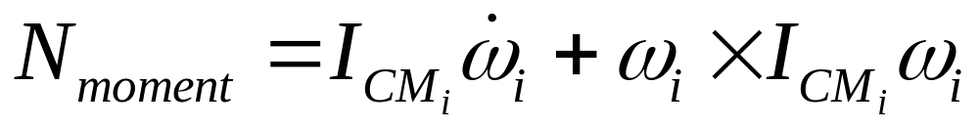
Physical Basis:
This method is jointly based on:
  Newton’s 2nd Law of Motion Equation:
  and considering a ‘rigid’ link
  Euler’s Angular Force/ Moment Equation:

Slide 3
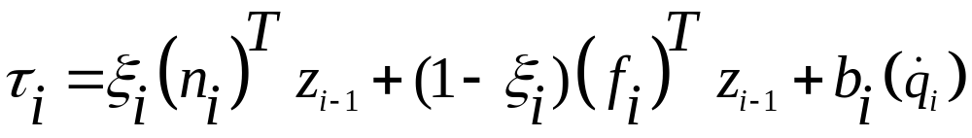
Again we will Find A “Torque” Model
Each Link Individually
We will move from Base to End to find Velocities and Accelerations
We will move from End to Base to compute force (f) and Moments (n)
Finally we will find that the Torque is:
_{i} is the joint type parameter (is 1 if revolute; 0 if prismatic) like in Jacobian!
Gravity is implicitly included in the model by considering acc₀ = g where g is (0, -g₀, 0) or (0, 0, -g₀)

Slide 4
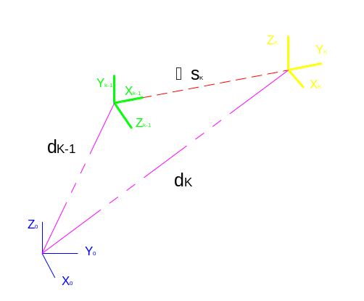
Lets Look at a Link “Model”

Slide 5
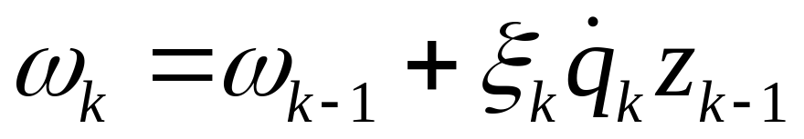
We will Build Velocity Equations
Consider that _{i} is the joint type parameter (is 1 if revolute; 0 if prismatic)
Angular velocity of a Frame k relative to the Base:
NOTE: if joint k is prismatic, the angular velocity of frame k is the same as angular velocity of frame k-1!

Slide 6
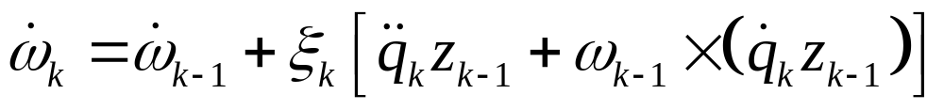
Angular Acceleration of a “Frame”
Taking the Time Derivative of the angular velocity model of Frame k:
Same as  (dw/dt) the angular acceleration in dynamics

Slide 7
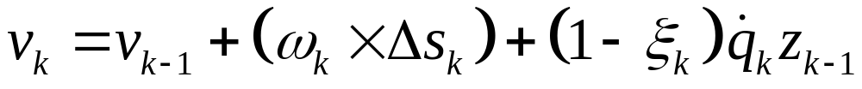
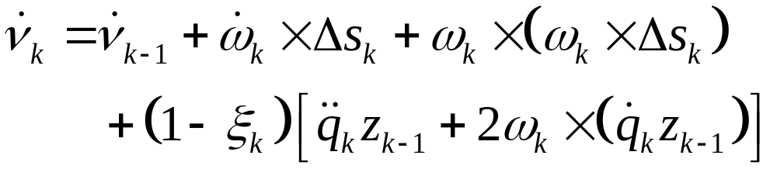
Linear Velocity of Frame k:
Defining s_{k} = d_{k} – d_{k-1} as a link vector, Then the linear velocity of link K is:
Leading to a Linear Acceleration Model of:
Normal component of acceleration (centrifugal acceleration)

Slide 8
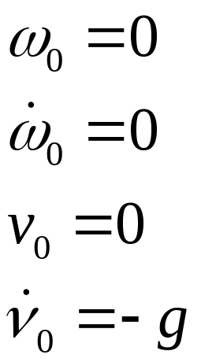
This completes the Forward Newton-Euler Equations:
To evaluate Link velocities & accelerations, start with the BASE (Frame₀)
Its Set V & A set (for a fixed or inertial base) is:
As advertised, setting base linear acceleration propagates gravitational effects throughout the arm as we recursively move toward the end!

Slide 9
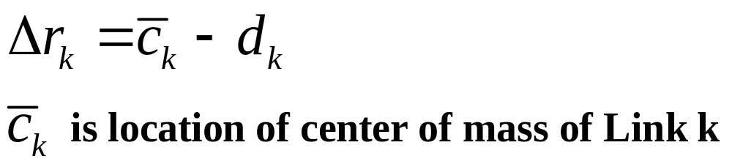
Now we define the Backward (Force/Moment) Equations
Work Recursively from the End
We define a term Δr_{k} which is the vector from the end of a link to its center of mass:

Slide 10
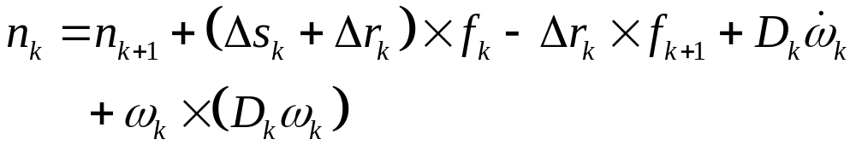
Defining f and n Models
The term in the brackets represents the linear acceleration of the center of mass of Link k
Inertial Tensor of Link k – in base space

Slide 11
Combine them into Torque Models:
We will begin our recursion by setting f_{n+1} = -f_{tool} and n_{n+1}= -n_{tool}
  Force and moment on the tool
NOTE: For a robot moving freely in its workspace without carrying a payload, f_{tool} = 0

Slide 12
The N-E Algorithm:
Step 1: set T₀⁰ = I; f_{n+1} = -f_{tool}; n_{n+1} = -n_{tool}; v₀ = 0;
v^{dot}₀ = -g; ₀ = 0; ^{dot}₀ = 0
Step 2: Compute –
    Z_{k-1}’s
    Angular Velocity & Angular Acceleration of Link k
    Compute s_{k}
    Compute Linear velocity and Linear acceleration of Link k
Step 3: set k = k+1, if k<=n back to step 2 else set k = n and continue

Slide 13
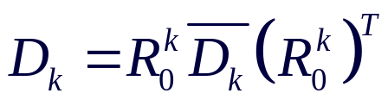
The N-E Algorithm cont.:
Step 4: Compute –
    r_{k} (related to center of mass of Link k)
    f_{k} (force on link k)
    N_{k} (moment on link k)
    t_{k}
Step 5: Set k = k-1. If k>=1 go to step 4

Slide 14
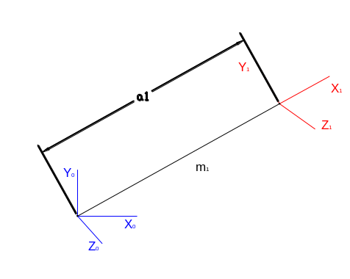
So, Lets Try one:
Keeping it Extremely Simple
This 1-axis ‘robot’ is called an Inverted Pendulum
It rotates about z₀ “in the plane”

Slide 15
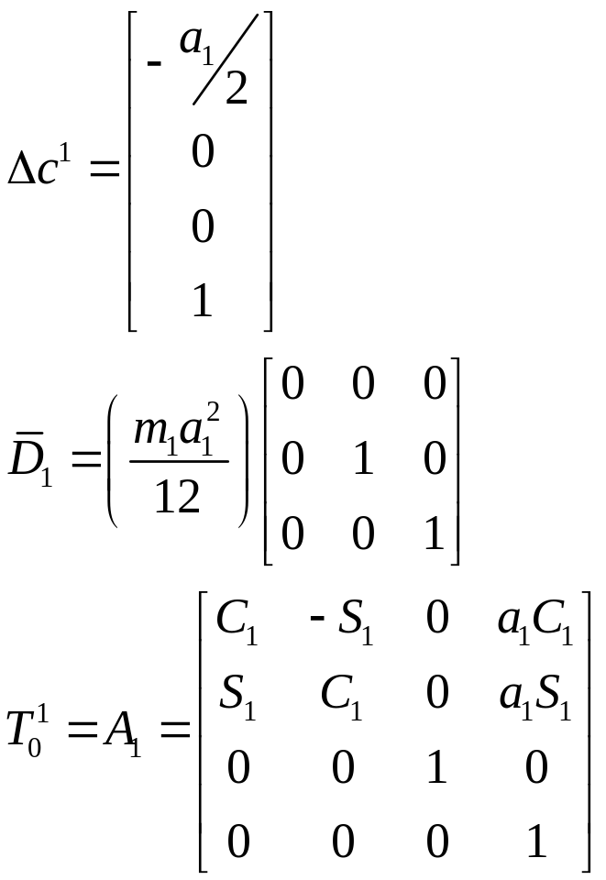
Writing some info about the device:
“Link” is a thin cylindrical rod

Slide 16
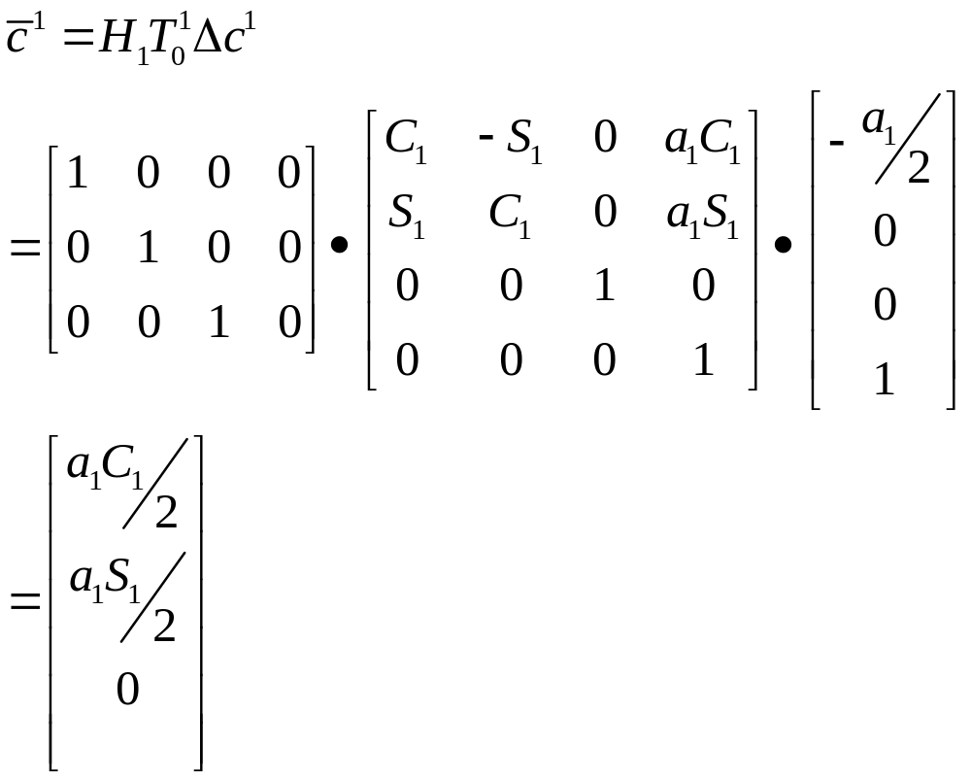
Continuing and computing:

Slide 17
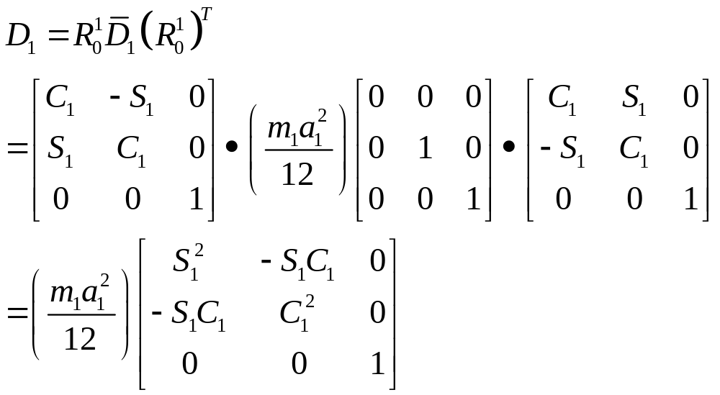
Inertial Tensor computation:

Slide 18
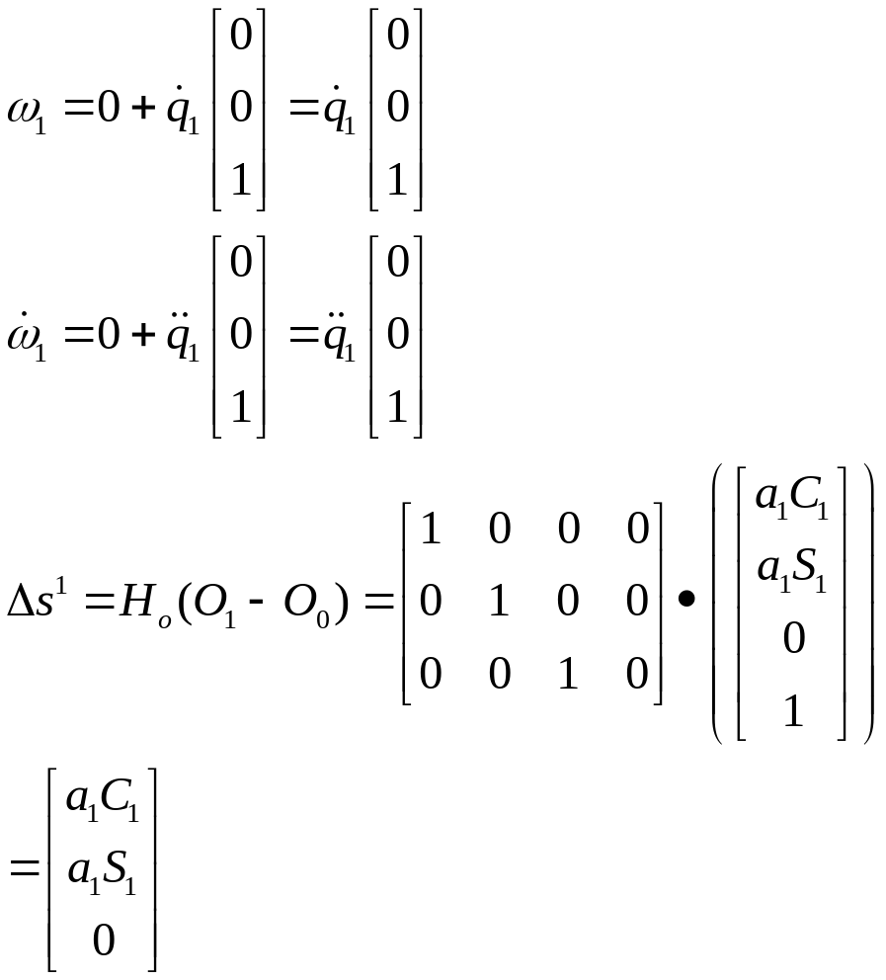
Let Do it (Angular Velocity & Accel.)!
Starting: Base (i=0)
Ang. vel = Ang. acc = Lin. vel = 0
Lin. Acc = -g (0, -g₀, 0)^{T}
₁ = 1

Slide 19
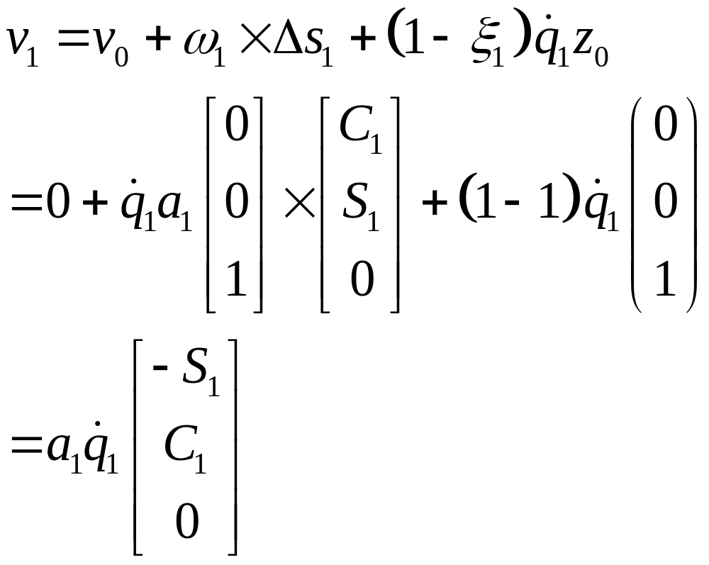
Linear Velocity:

Slide 20
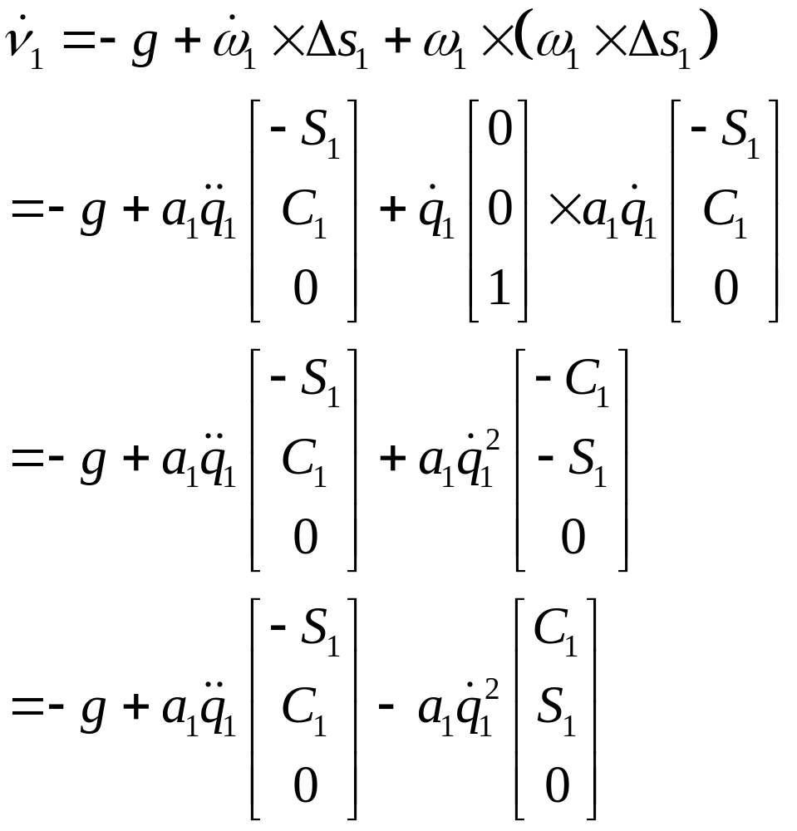
Linear Acceleration:
Note:
g = (0, -g₀, 0)^{T}

Slide 21
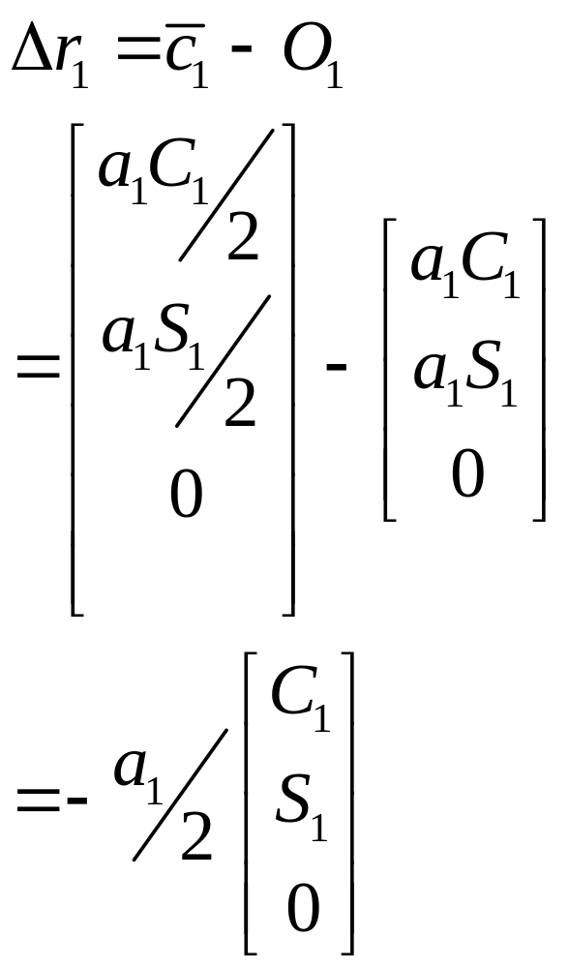
Thus Forward Activities are done!
Compute r₁ to begin Backward Formations:

Slide 22
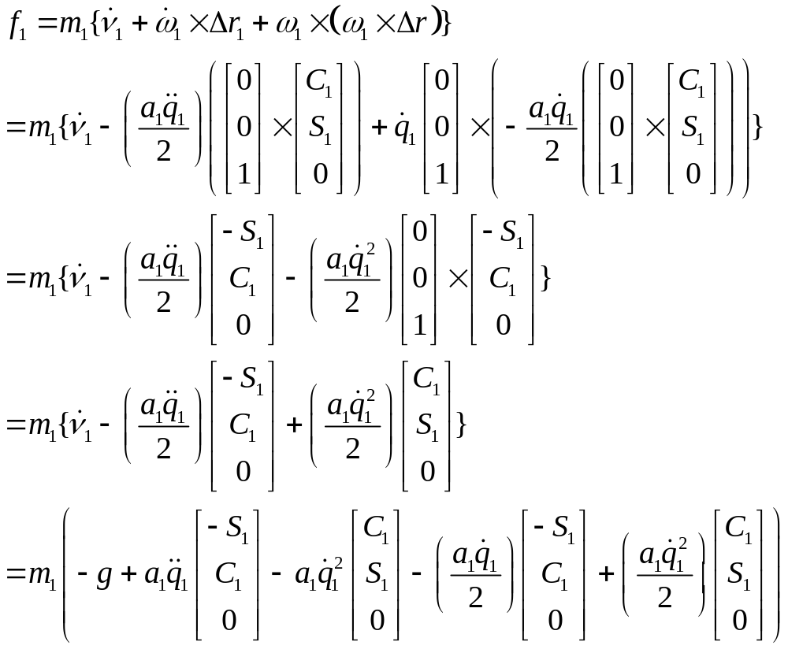
Finding f₁
Consider: f_{tool} = 0

Slide 23
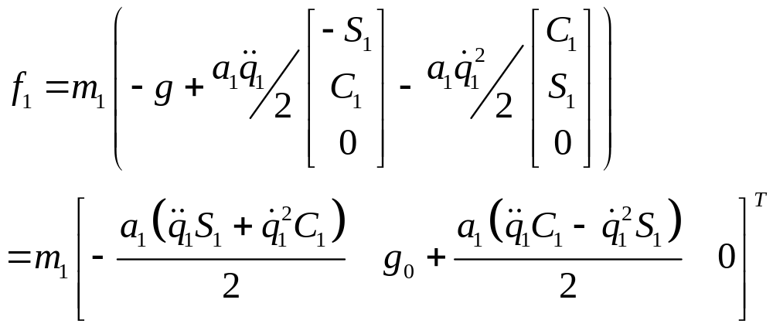
Collapsing the terms
Note f₁ is a Vector!

Slide 24
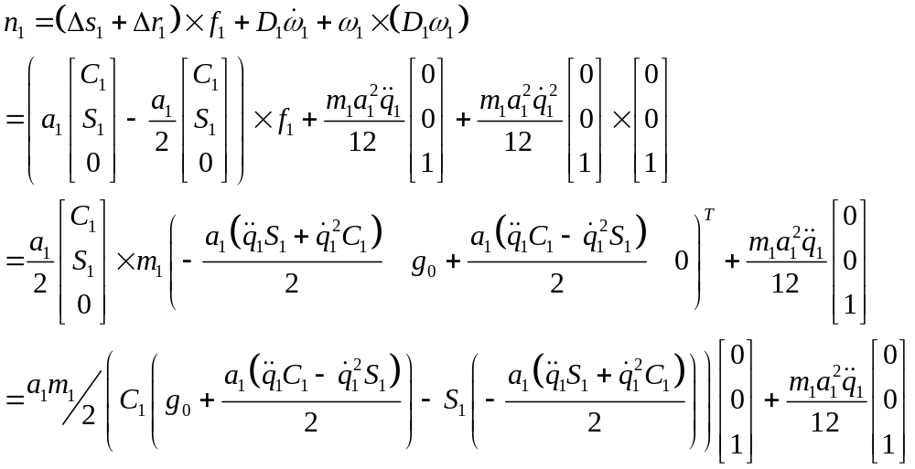
Computing n₁:
This X-product goes to Zero!
The Link Force Vector

Slide 25
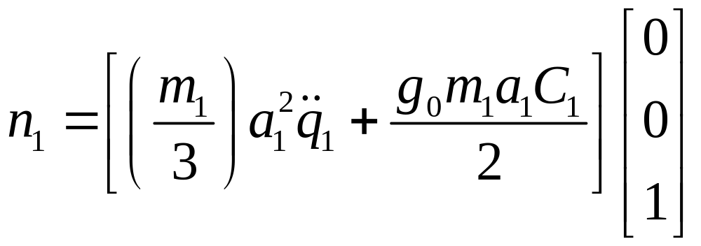
Simplifying:

Slide 26
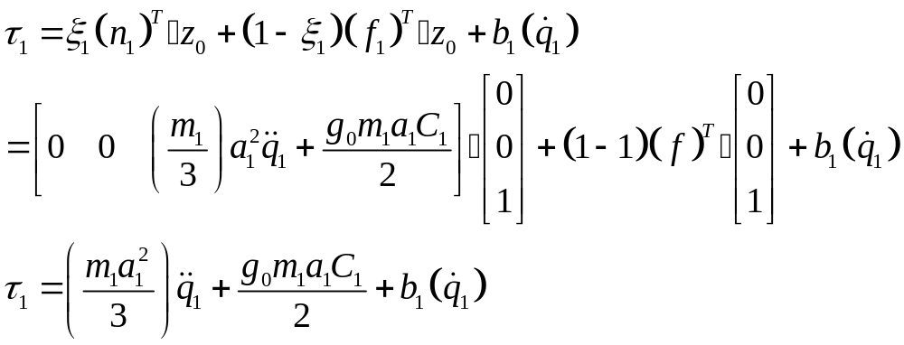
Writing our Torque Model
‘Dot’ (scalar) Products

Slide 27
Homework Assignment:
Compute L-E solution for “Inverted Pendulum & Compare torque model to N-E solution
Compute N-E solution for 2 link articulator (of slide set: Dynamics, part 2) and compare to our L-E torque model solution computed there
Consider Our 4 axis GMF cylindrical robot – if the links can be simplified to thin cylinders, develop a generalized torque model for the device.

